Slide 1
PHARMACOLOGY OF DOPAMINE PHA 302:AUTONOMIC NERVOUS SYSTEM
BY
Pharm F.A OLADOJA.
B.Pharm, M.Sc., ACISM(USA), ACIWM, ACA
Department of Pharmacology and Toxicology,
Faculty of Pharmacy,
Olabisi Onabanjo University.

Slide 2
LET’S REFLECT
Mr Bayo, a 68year old Parkinson's victim regains control of his body with L-dopa.
Mr Edith, a schizophrenic man paralyzed by fear and hallucinations is freed from a mental institution by clozapine.
Mr Rufai, a meth addict lies, cheats, and steals, ending up emaciated and dead.
DID YOU KNOW all the aforementioned is related to a single molecule—dopamine

Slide 3
HISTORY
1910- first synthesised by
• George Barger and
• James Ewens (London)
1940s Peter Holtz
• Dopa decarboxylase enzyme
• Oleh Hornykiewicz (1956)- L-DOPA in Parkinson's disease,
• Arwid Carlsson(1958,2000) dopamine as neurotransmitter

Slide 4
HISTORY OF DOPAMINE
The function of dopamine as a neurotransmitter was discovered in 1958 by Arvid Carlsson and Nils-Åke Hillarp at the Laboratory for Chemical Pharmacology of the National Heart Institute of Sweden.
It was named dopamine because it was a monoamine, and its synthetic precursor was 3,4-dihydroxyphenylalanine .
Arvid Carlsson was awarded the 2000 Nobel prize for physiology or medicine for showing that dopamine is not just a precursor of norepinephrine (noradrenaline) and epinephrine (adrenaline) but a neurotransmitter, as well.

Slide 5
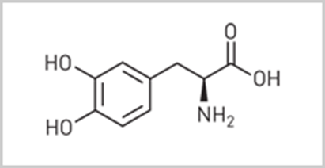
INTRODUCTION
Dopamine belongs to the family of catecholamines
Hormones, Epinephrine and Norepinephrine (other catecholamines) are derived from Dopamine
Dopamine is the major catecholamine neurotransmitter in the brain which regulates multiple functions including the control over voluntary action, reward, consciousness, and cognition

Slide 6
INTRODUCTION
Dopamine is an endogenous catecholamine and the immediate metabolic precursor of norepinephrine.
It stimulates alpha- and beta-adrenergic receptors directly and indirectly.
In addition, it acts on specific dopaminergic receptors.

Slide 7
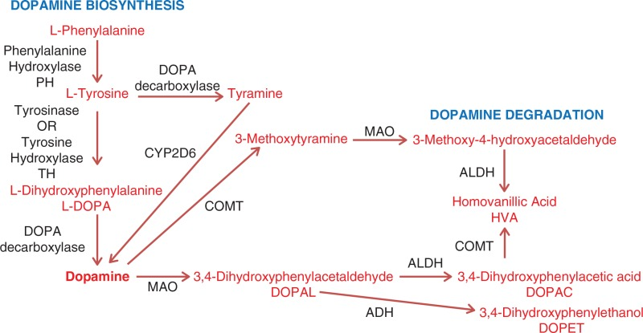
SYNTHESIS

Slide 8
PHARMACODYNAMICS
Dopamine is a natural catecholamine formed by the decarboxylation of 3,4-dihydroxyphenylalanine (DOPA).
It is a precursor to norepinephrine in noradrenergic nerves and is also a neurotransmitter in certain areas of the central nervous system, especially in the nigrostriatal tract, and in a few peripheral sympathetic nerves.

Slide 9
PHARMACODYNAMICS
Dopamine produces positive chronotropic and inotropic effects on the myocardium, resulting in increased heart rate and cardiac contractility.
This is accomplished directly by exerting an agonist action on beta-adrenoceptors and indirectly by causing release of norepinephrine from storage sites in sympathetic nerve endings

Slide 10
PHARMACOKINETICS
Absorption
Dopamine is rapidly absorbed from the small intestine.
Distribution
widely distributed in the central nervous system (CNS)
and some peripheral areas including cardiovascular and renal system
Dopamine not effective orally and does not cross blood brain barrier.

Slide 11
PHARMACOKINETICS
Metabolism
Biotransformation of dopamine proceeds rapidly to yield the principal excretion products, 3-4-dihydroxy-phenylacetic acid (DOPAC) and 3-methoxy-4-hydroxy-phenylacetic acid (homovanillic acid, HVA).
Excretion
80% of the dopamine is excreted in the urine within 24 hours, primarily as HVA and its sulfate and glucuronide conjugates and as 3,4-dihydroxyphenylacetic acid.
A very small portion is excreted unchanged
it is used only intravenously

Slide 12
MECHANISM OF ACTION
Dopamine is a precursor to norepinephrine in noradrenergic nerves and is also a neurotransmitter in certain areas of the central nervous system.
In the brain, dopamine act as an agonist to the five dopamine receptor subtypes (D1, D2, D3, D4, D5)

Slide 13
MECHANISM OF ACTION
At low dose (0.5 to 3 mic /kg /min ):-
Selectively activates dopamine specific receptors in the renal and splanchnic circulation. Increase blood flow in these region.
Low dose dopamine also directly affects renal tubular epithelial cells.
It causes an increase in urinary Na
Intermediate dose(3 to 10 mic /kg /min ):-
It stimulates B1 receptors in the heart and peripheral circulation.
Increases myocardial contractility, increases heart rate and peripheral vasodilatation
Over all there is an increase in cardiac output

Slide 14
MECHANISM OF ACTION
At high dose (> 10 mic /kg / min ):-
Dopamine produces a progressive activation of alpha receptors in the systemic and pulmonary circulation resulting in progressive pulmonary and systemic vasoconstriction

Slide 15
TARGETS
Targets | Actions | Organism
Dopamine D1 receptor | agonist | Humans
Dopamine D2 receptor | agonist | Humans
Dopamine D3 receptor | agonist | Humans
Dopamine D4 receptor | agonist | Humans
Dopamine D5 receptor | agonist | Humans

Slide 16
CLINICAL USES/INDICATIONS
Dopamine is often used in situation where cardiac stimulation is desired such as in cardiogenic shock
It is also used to correct the hypotension in the septic shock but norepinephrine become the preferred vasopressor in this condition
Low dose is often used in an attempt to prevent or reverse acute renal failure

Slide 17
CLINICAL USES/INDICATIONS
Dopamine (DA) is a peripheral vasostimulant used to treat low blood pressure, low heart rate, and cardiac arrest, especially in acute neonatal cases via a continuous intravenous drip
Low infusion rates (0.5 to 2 micrograms/kg per minute) act on the visceral vasculature to produce vasodilation, including the kidneys, resulting in increased urinary flow.

Slide 18
CLINICAL USES/INDICATIONS
Intermediate infusion rates (from 2 to 10 micrograms/kg/min) stimulate myocardial contractility and increase electrical conductivity in the heart leading to increased cardiac output.
Higher doses cause vasoconstriction and increased blood pressure via the adrenergic receptors alpha-1and beta-1,
Indications also include maintenance of blood pressure for chronic congestive heart failure, trauma, renal failure, and even open-heart surgery.

Slide 19
DOPAMINE IN PULMONARY EDEMA
The sympathomimetic amines dopamine is potent ionotropic agents
Used in pulmonary edema.
Forcefully contracts the heart and thus decreases the pulmonary load

Slide 20
DOSE AND ADMINISTRATION
Commercial preparation of dopamine are concentrated drug solution [Containing 40 mg /80 mg dopamine HCL /ml]
Provided in small volume vial / ampoule in 5 ml /10 ml
The preparation must be diluted to prevent intense vasoconstriction during drug infusion
Dopamine solution diluted 100-fold in isotonic saline to prepare the infusate
Always delivered into , large central veins

Slide 21
DOSING
Weight based
There are two recommended doses:-
3 to 10 mic /kg /min is for augmenting cardiac output thereby increasing BP
More than 10 mic /kg /min is recommended to increase the blood pressure directly
Dopamine is inactivated by higher PH So ,alkaline fluids should not be infused along with dopamine

Slide 22
ADVERSE EFFECTS
Tachyarrhythmia's are the most common adverse effects of dopamine
The most feared complication of dopamine infusion is limb necrosis
Allergic reactions
Continuous infusion of dopamine increase intraocular pressure
Hyperglycemia is commonly present in individuals receiving a continuous infusion of dopamine as a result of drug induced inhibition of insulin secretion

Slide 23
DRUG INTERACTIONS
Cyclopropane
Bromocriptine
Dyhydroergotamine
Halothane
Linezolid
Phenytoin

Slide 24
CONTRAINDICATIONS
Individuals receiving MAO inhibitors
Tricyclic antidepressants agents
Pheochromocytoma
Uncorrected tachyarrhythmias
If dopamine liquid falls on floor /cloth it gives permanent staining if allowed to dry and was not mopped off wet

Slide 25
.
DOPAMINE AND IT’S DISORDERS

Slide 26
RECEPTORS
Dopamine acts through D1 , D2 as well as adrenergic alpha and B1 receptors ( But not B2)
D1 and D2 receptors are the most abundant and widespread in areas receiving a dopaminergic innervation (namely the striatum ,limbic system, thalamus and hypothalamus) D2 receptors, also occur in the pituitary gland

Slide 27
DOPAMINE
Dopamine neurons are more widely distributed than those of other monamines, residing in the midbrain substantia nigra and ventral tegmental area and in the periaqueductal gray, hypothalamus, olfactory bulb, and retina.
• In the periphery, dopamine is found in the kidney where it functions to produce renal vasodilation, diuresis, and natriuresis.
• Three dopamine systems are highly relevant to psychiatry: The nigrostriatal, mesocorticolimbic, and tuberohypophyseal system.

Slide 28
TRACTS IN THE BRAIN
The Mesolimbic Dopamine Pathway : midbrain ventral tegmental area to the nucleus accumbens .a part of the limbic system of the brain thought to be involved in many behaviours such as pleasurable sensations, the powerful euphoria of drugs of abuse, as well as delusions and hallucinations of psychosis.
The Mesocortical Dopamine Pathway : It also projects from the midbrain ventral tegmental area but sends its axons to areas of the prefrontal cortex, where they may have a role in mediating cognitive symptoms (dorsolateral prefrontal cortex) and affective symptoms (ventromedial prefrontal cortex) of schizophrenia.

Slide 29
TRACTS IN THE BRAIN
Nigrostriatal Dopamine Pathway : which projects from the substantia nigra to the basal ganglia or striatum, is part of the extrapyramidal nervous system and controls motor function and movement.
Tuberoinfundibular Dopamine Pathway : projects from the hypothalamus to the anterior pituitary gland and controls prolactin secretion.
The fifth dopamine pathway arises from multiple sites, including the periaqueductal gray, ventral mesencephalon, hypothalamic nuclei, and lateral parabrachial nucleus, and it projects to the thalamus. Its function is not currently well known.

Slide 30
DISORDERS ASSOCIATED WITH THE DOPAMINERGIC SYSTEM
Parkinsonism : Decrease Dopamine.
It occurs in substantia nigra
Leading to symptoms like
rigidity ,
bradykinesia and
tremors

Slide 31
SUBSTANCE ABUSE
Substance Abuse :
Nucleus accumbens is a centre for reward.
Occurs due to increased release of dopamine caused by the psychotropic substances like
morphine
heroin
Cannabis
cocaine
nicotine

Slide 32
DISORDERS OF DOPAMINE
ADHD :
Decrease In Dopamine Level in anterior frontal cortex
An area associated with cognitive function such as
Attention
concentration.
Impulse Control Disorder : Decrease In Dopamine Level

Slide 33
DISORDERS OF DOPAMINE
Depression :
Decrease Of Dopamine in following areas
VMPFC- Depressed mood
PFC, Hypothalamus,
Nucleus Accumbens - Apathy
Nucleus Accumbens Striatum Hypothalamus- Fatigue
Nucleus Accumbens ,PFC – Psychomotor Agitation/Retardation

Slide 34
DISORDERS OF DOPAMINE
Schizophrenia :
Increase And Decrease Of Dopamine In Different Region Of Brain.
Mesolimbic pathways
Mesocortical pathways

Slide 35
DOPAMINE AGONIST
Dopamine Agonist:
Levodopa
Carbidopa
Ropinirole

Slide 36
.
MANY THANKS FOR YOUR RAPT ATTENTION

